Slide 1
PROJECT PRESENTATION
JUICE ROBO
FRONTEND REDESIGN
Modernizing the customer experience while reusing the existing e-commerce backend
UI improvements • Existing APIs • UPI flow • Pickup code
SHORT TECHNICAL PRESENTATION
Notes:
The objective is to create a modern, mobile-friendly customer interface while continuing to use the existing Juice Robo e-commerce backend.”

Slide 2
Project scope
Frontend redesign—not a replacement for the existing e-commerce service.
Redesigned frontend
Existing backend
Integration goal
Updated responsive screens, layout, product cards, navigation, and user flow.
Reuse current APIs, database, order processing, and payment behavior.
Keep the current business logic and API contracts working with the new UI.
Guiding principle
Change the presentation layer. Do not duplicate backend functionality or introduce new authentication/payment flows without a verified need.
JUICE ROBO • FRONTEND REDESIGN + EXISTING API INTEGRATION
02
Notes:
Our scope is to redesign the existing frontend without replacing the backend. We are reusing the existing APIs, business logic, and order-processing system while improving the user interface, navigation, and overall customer experience.

Slide 3
How the redesigned UI works
The frontend consumes existing APIs and displays their responses.
Redesigned UI
Existing APIs
Existing backend
Location • Menu • Cart • Profile
Requests and responses
Database • Orders • Payment status
Location and menu APIs
Cart and order APIs
Outlet ID selects the correct menu; products and prices come from the API.
Keep add-to-cart, order submission, and status verification on existing service flows.
JUICE ROBO • FRONTEND REDESIGN + EXISTING API INTEGRATION
03
Notes:
The frontend communicates with the existing backend through APIs. These APIs retrieve outlet and menu information, synchronize cart data, submit orders, and check payment status. The backend continues to manage data storage, business logic, order processing, and payment verification.

Slide 4
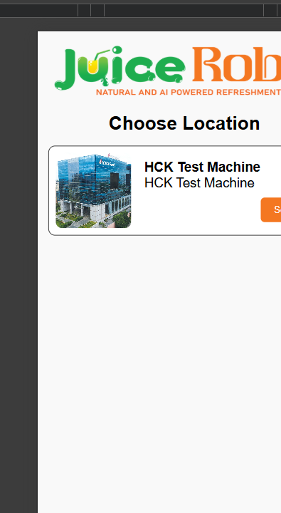
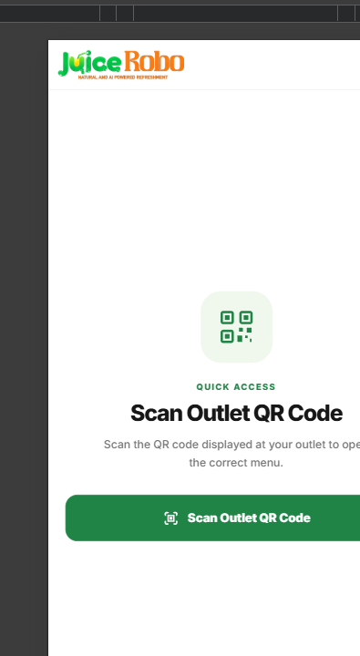
Location access: previous vs redesigned
Move from a manual location choice toward QR-based outlet access.
PREVIOUS UI
REDESIGNED UI
What changed
QR access is designed to identify the outlet and open its matching menu.
JUICE ROBO • FRONTEND REDESIGN + EXISTING API INTEGRATION
05
Notes:
“We implemented QR-based outlet access to simplify the customer journey. When customers scan the Juice Robo QR code, the frontend extracts the relevant outlet or menu identifier from the URL and uses the existing APIs to load the corresponding menu.

Slide 5
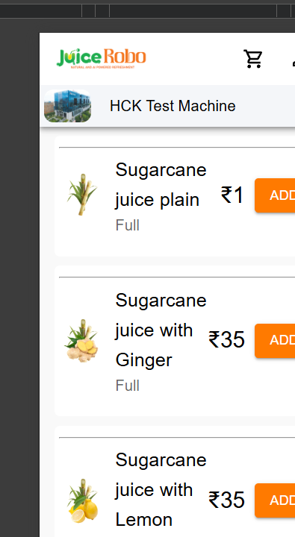
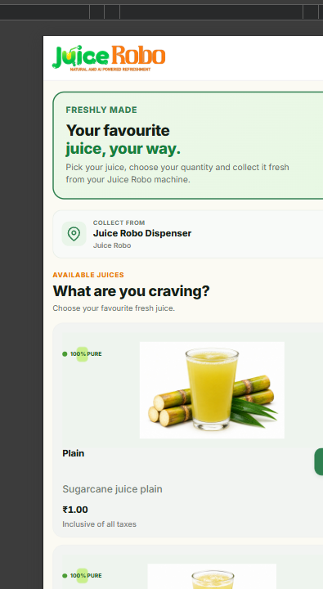
Menu screen: previous vs redesigned
Keep product data dynamic while improving readability and shopping flow.
PREVIOUS UI
REDESIGNED UI
What changed
The refreshed menu improves browsing; item names, prices, and availability remain API-driven.
JUICE ROBO • FRONTEND REDESIGN + EXISTING API INTEGRATION
06
Notes:
We redesigned the menu screen to provide a cleaner and more intuitive browsing experience. Product images, names, and prices are displayed clearly, allowing customers to browse products and add items to their cart. The product information continues to come from the existing backend APIs.

Slide 6
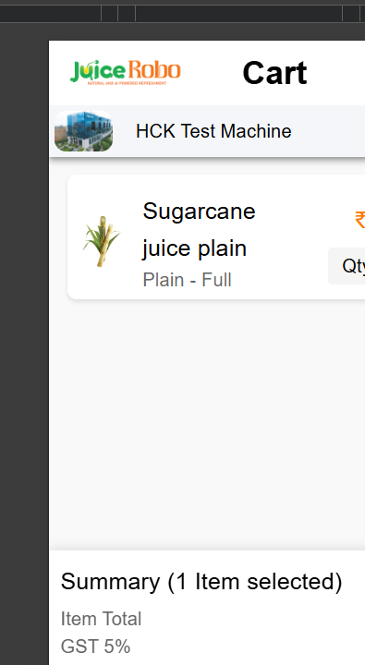
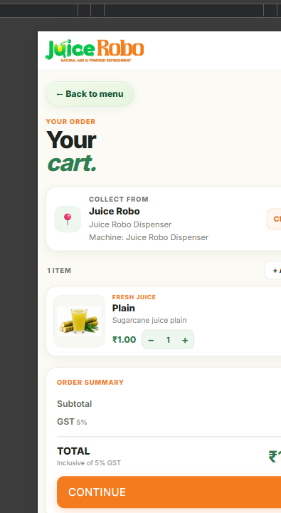
Cart screen: previous vs redesigned
Latest cart UI: outlet/machine, item quantity, GST breakdown, and total in one flow.
PREVIOUS UI
REDESIGNED UI
What changed
The cart groups collection details, quantity controls, subtotal, 5% GST, total, and Continue. Existing order and payment logic remains in use.
JUICE ROBO • FRONTEND REDESIGN + EXISTING API INTEGRATION
07
Notes:
The redesigned cart allows customers to review selected products and manage quantities. We improved the checkout screen to display order details, applicable GST, and the final payable amount clearly. Cart operations are synchronized with the backend to maintain consistency throughout the ordering process.

Slide 7
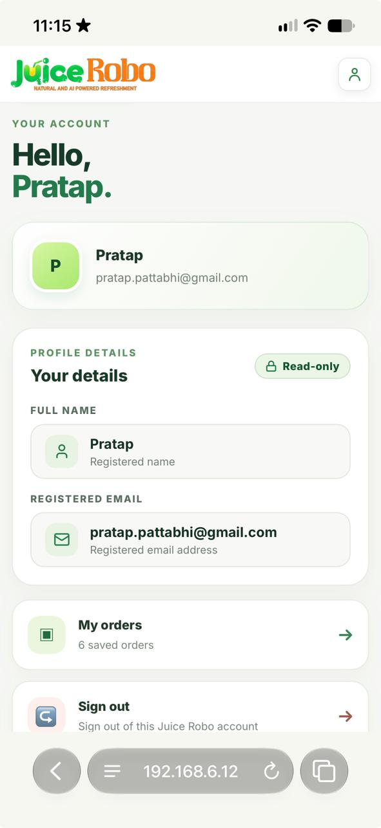
New addition: profile screen
A redesigned account area extends the existing customer experience.
Profile details
Shows the registered customer name and email in read-only fields.
Account navigation
Provides access to saved orders and sign-out from the Juice Robo account.
Profile data is displayed as read-only. The screen also links to saved orders and sign-out.
JUICE ROBO • FRONTEND REDESIGN + EXISTING API INTEGRATION
08
Notes:
The Profile Screen displays the customer’s registered name and email address using authenticated account data. These details cannot be edited after account creation. Customers can access the My Orders section to view their orders and sign out.
Need to do – Giving Menu access without login.

Slide 8
UPI payment and 4-digit pickup code
Open the payment app, then trust the backend—not the app handoff.
Checkout
UPI app
Backend verifies
Success UI
Confirm order total
Customer authorizes
Check order/payment status
Display returned pickup code
Payment rules
Pickup code rules
Handle pending, cancelled, and failed payments. Show success only after backend confirmation.
Display the unique 4-digit code returned by the existing backend. Never fabricate it in frontend code.
If the current backend does not generate or return a pickup code, that is a separate backend requirement—not just a frontend change.
JUICE ROBO • FRONTEND REDESIGN + EXISTING API INTEGRATION
09
Notes:
We improved the payment flow to support payments through the customer’s preferred UPI application. After payment is initiated, the frontend checks the order and payment status through the existing backend APIs. The payment success screen appears only after the backend confirms successful payment. Once the order is confirmed, the customer receives a unique four-digit pickup code to collect the order.

